Slide 1
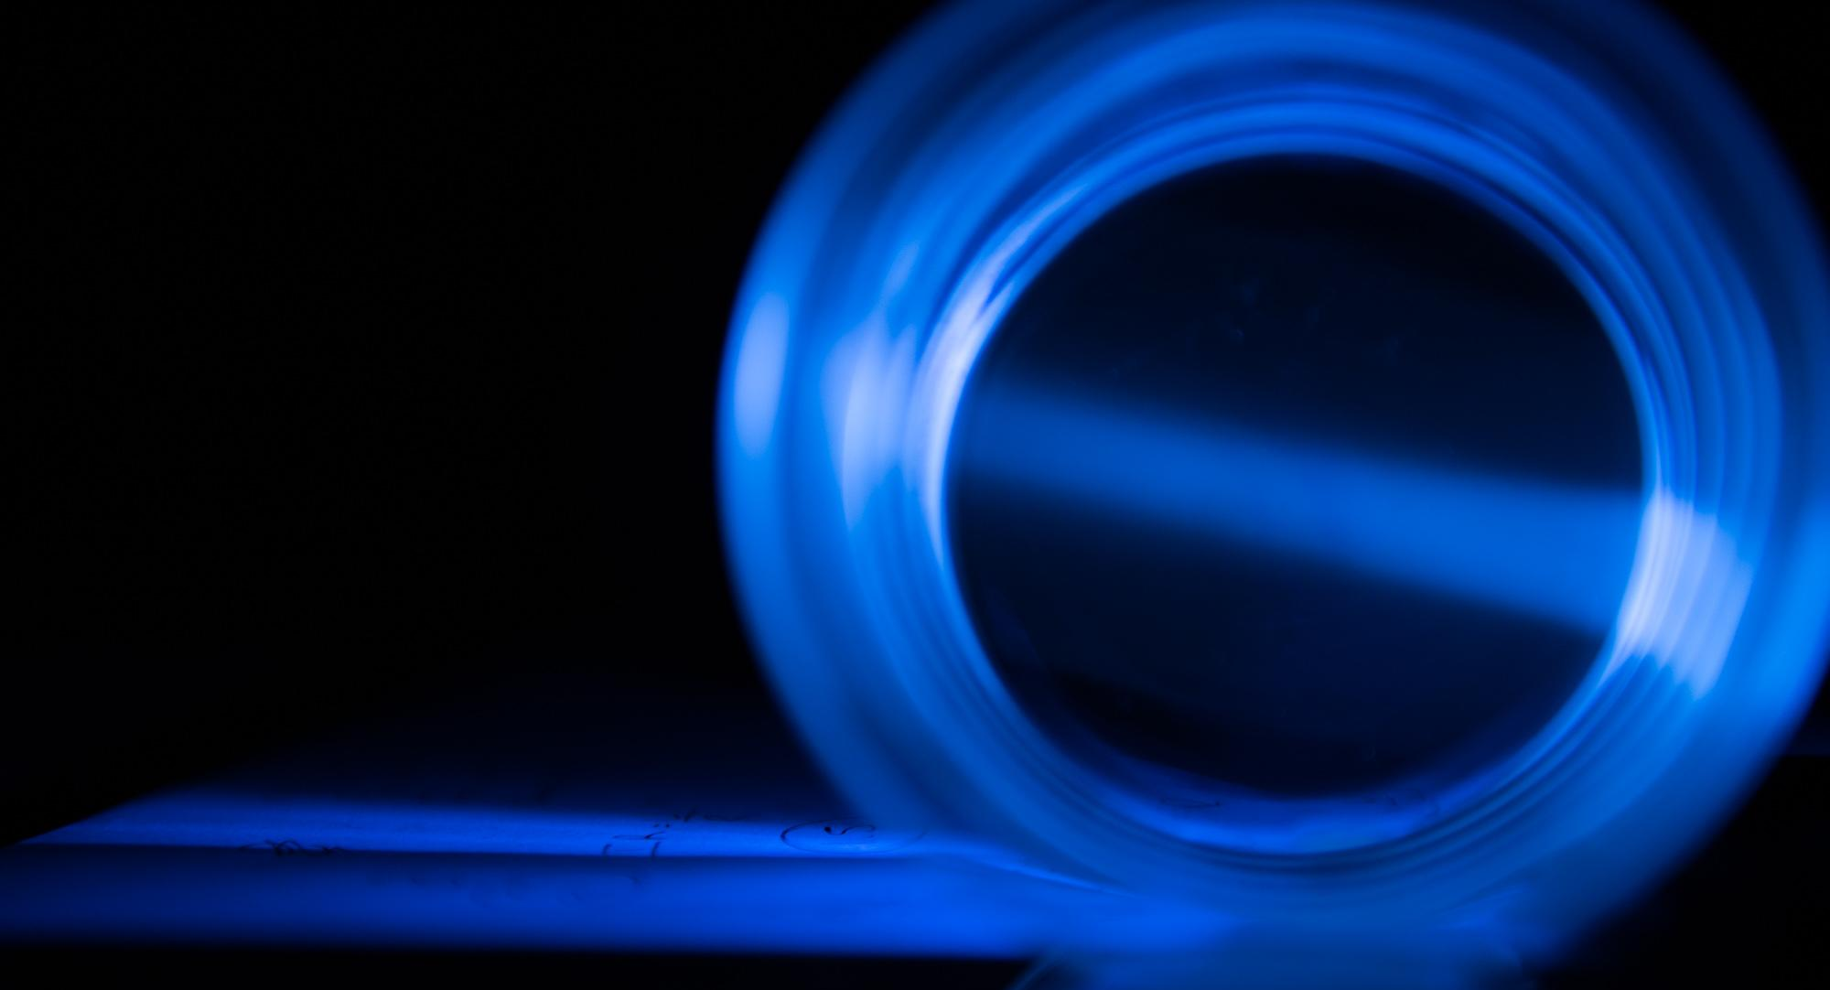
Neural Networks in Optical Sensors
Umberto Michelucci
ODSC Meetup @ Google - 13th Nov. 2019

Slide 2
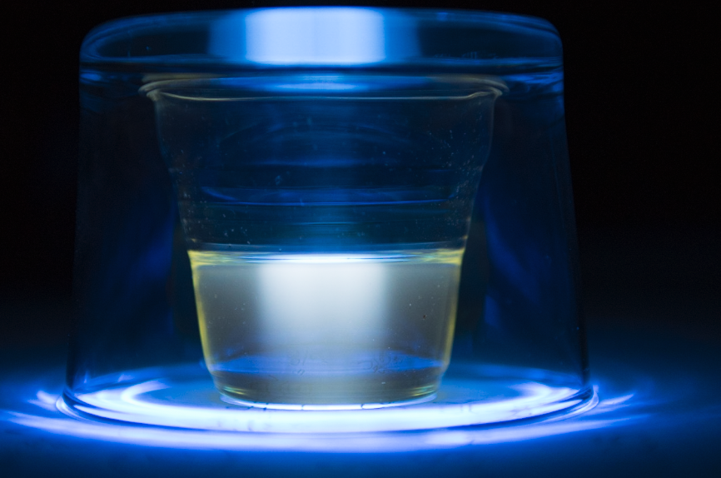

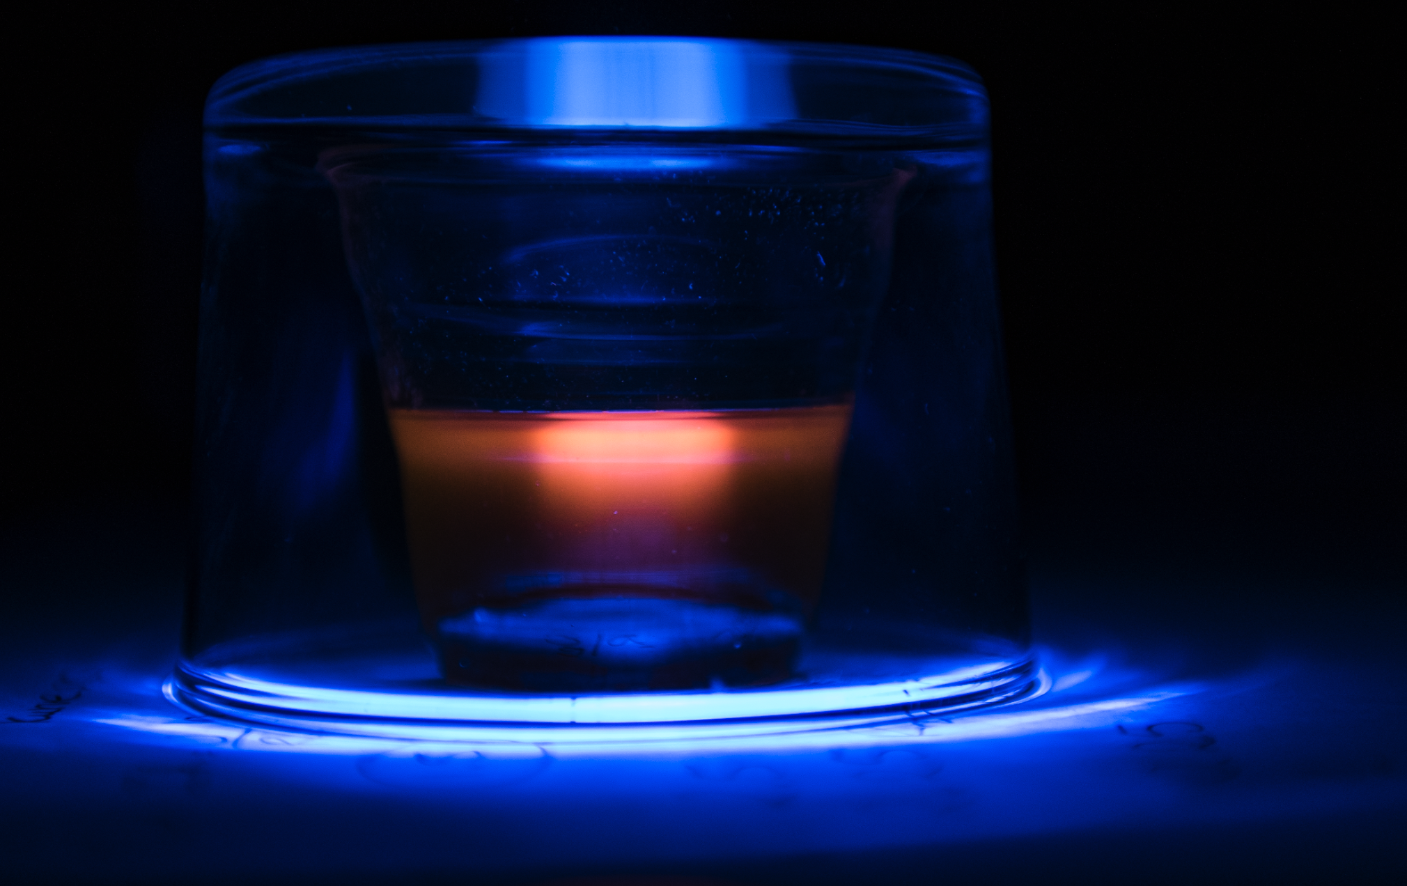
Colour of Taste Project

Slide 3
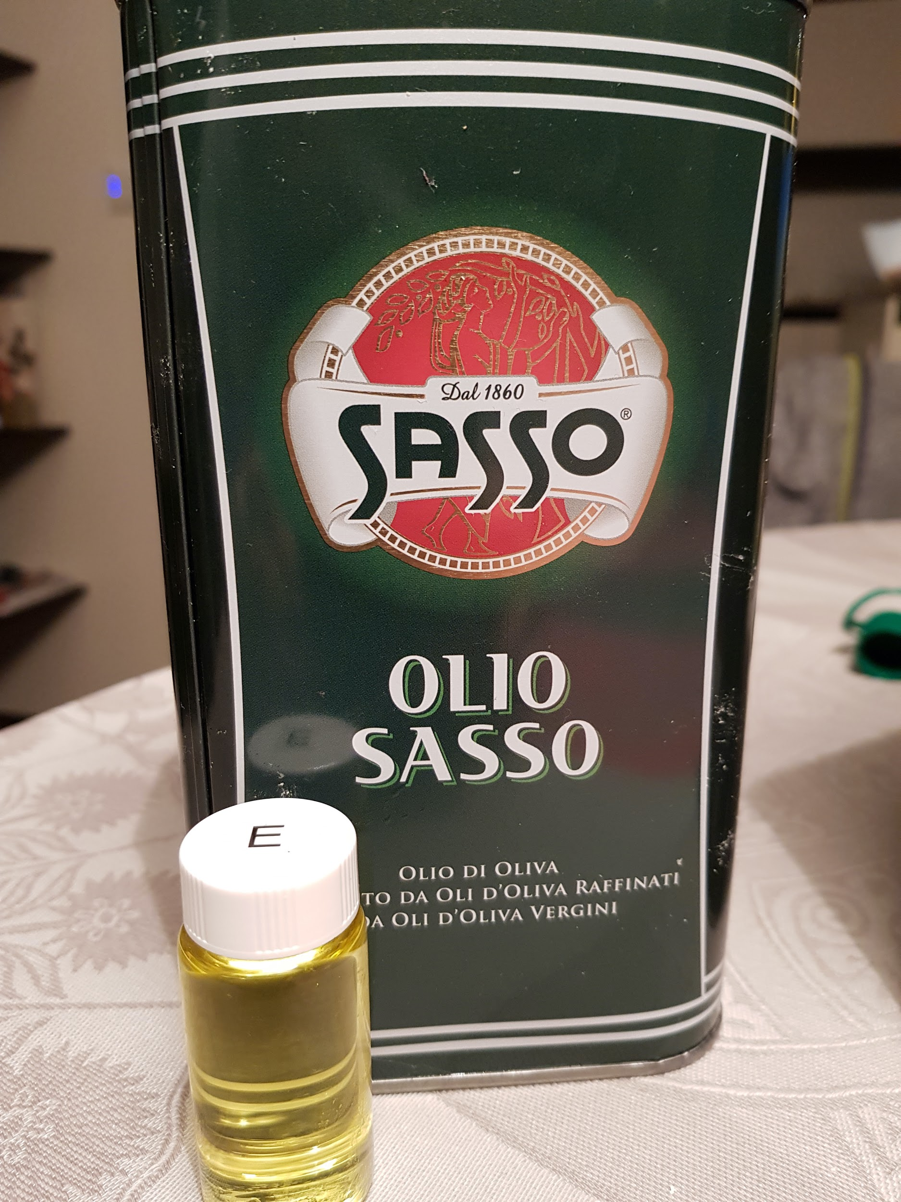
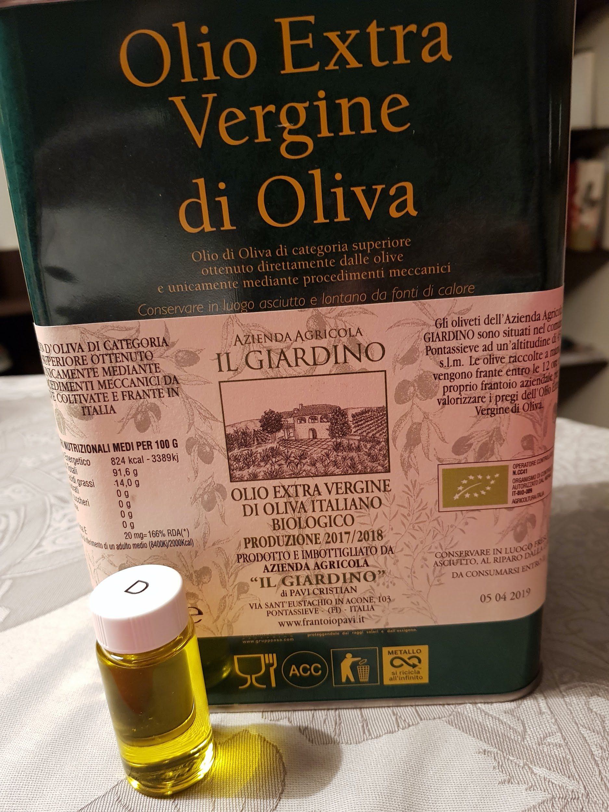
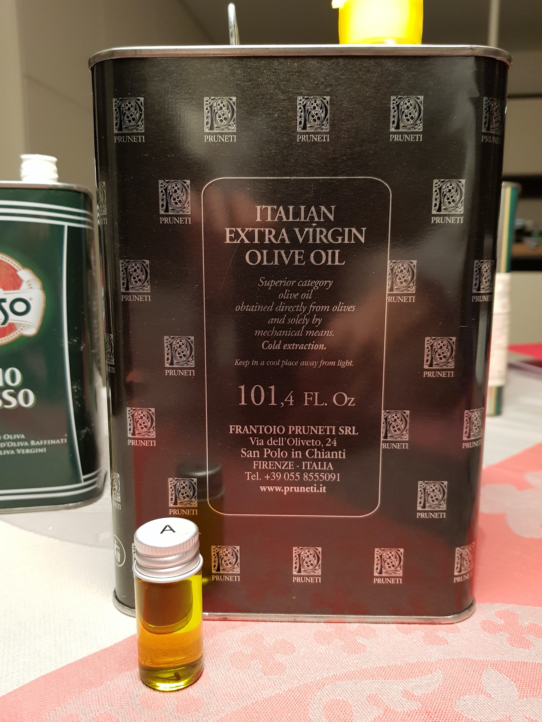
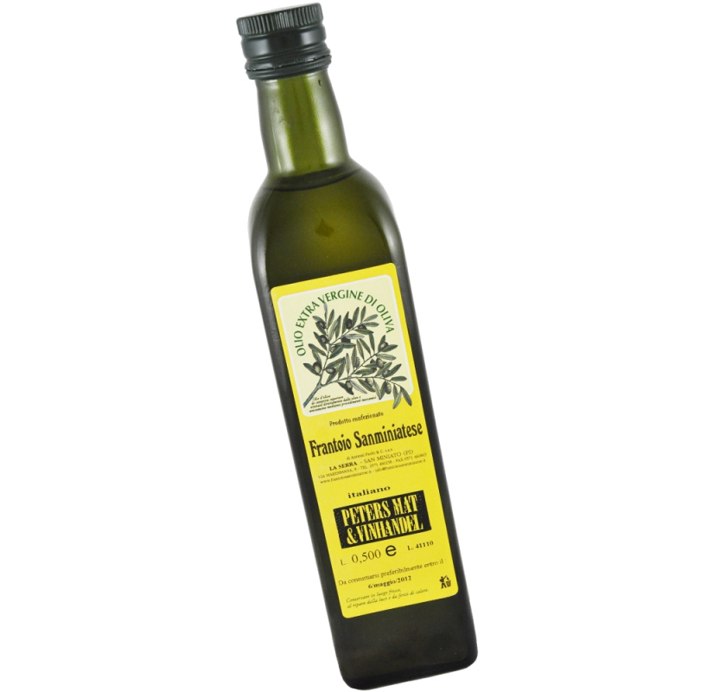
Different Olive Oil Types
B

Slide 4
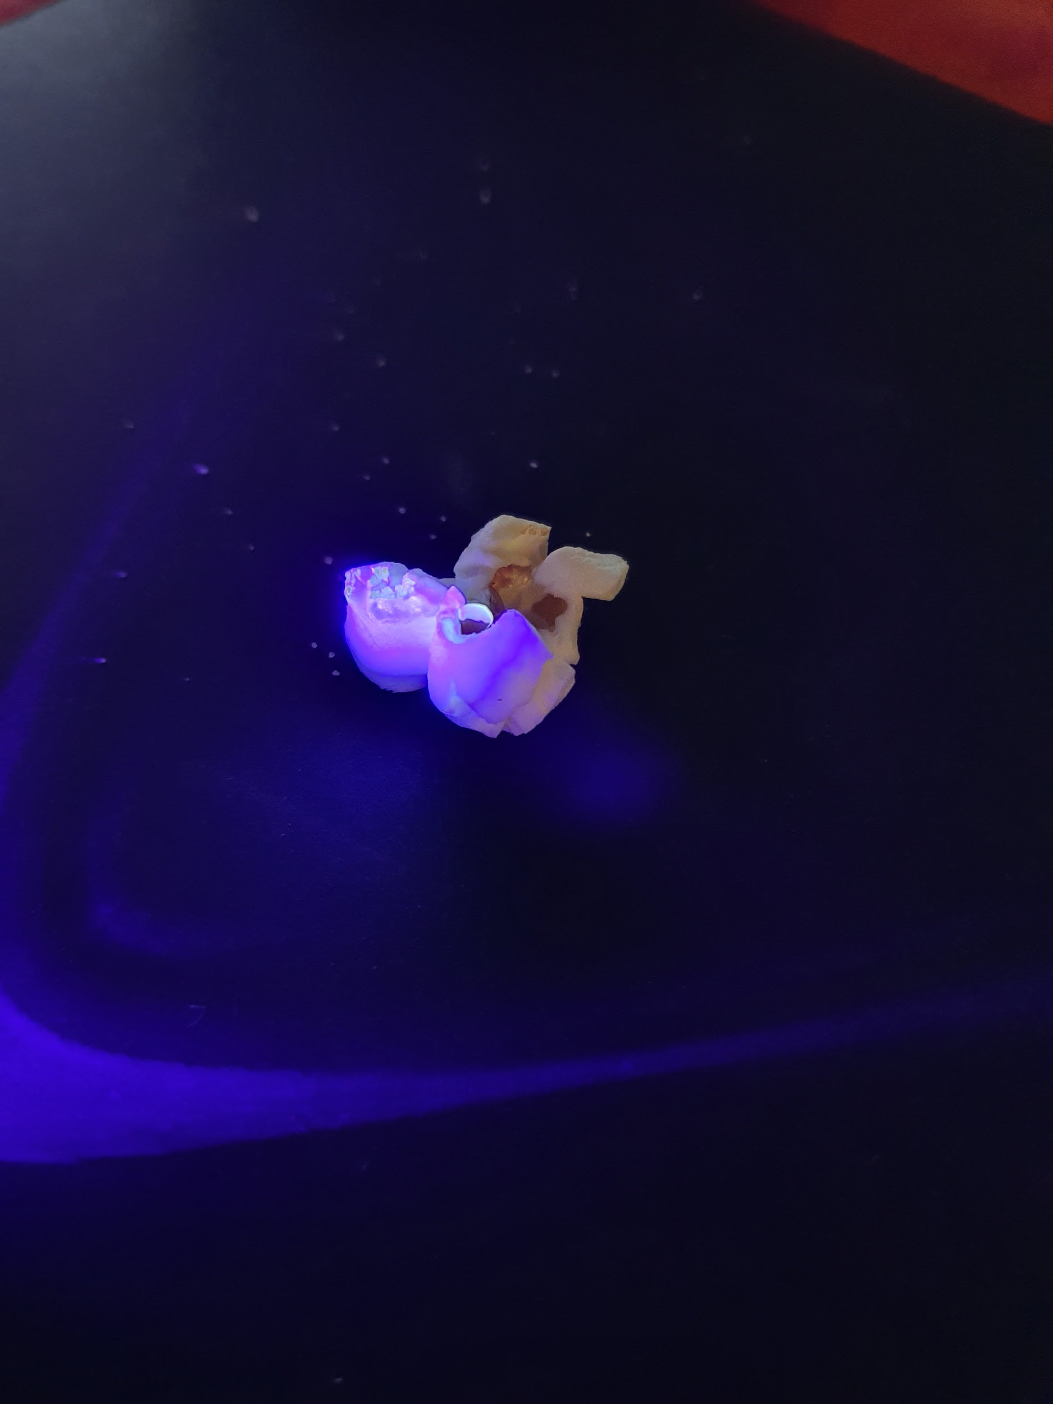
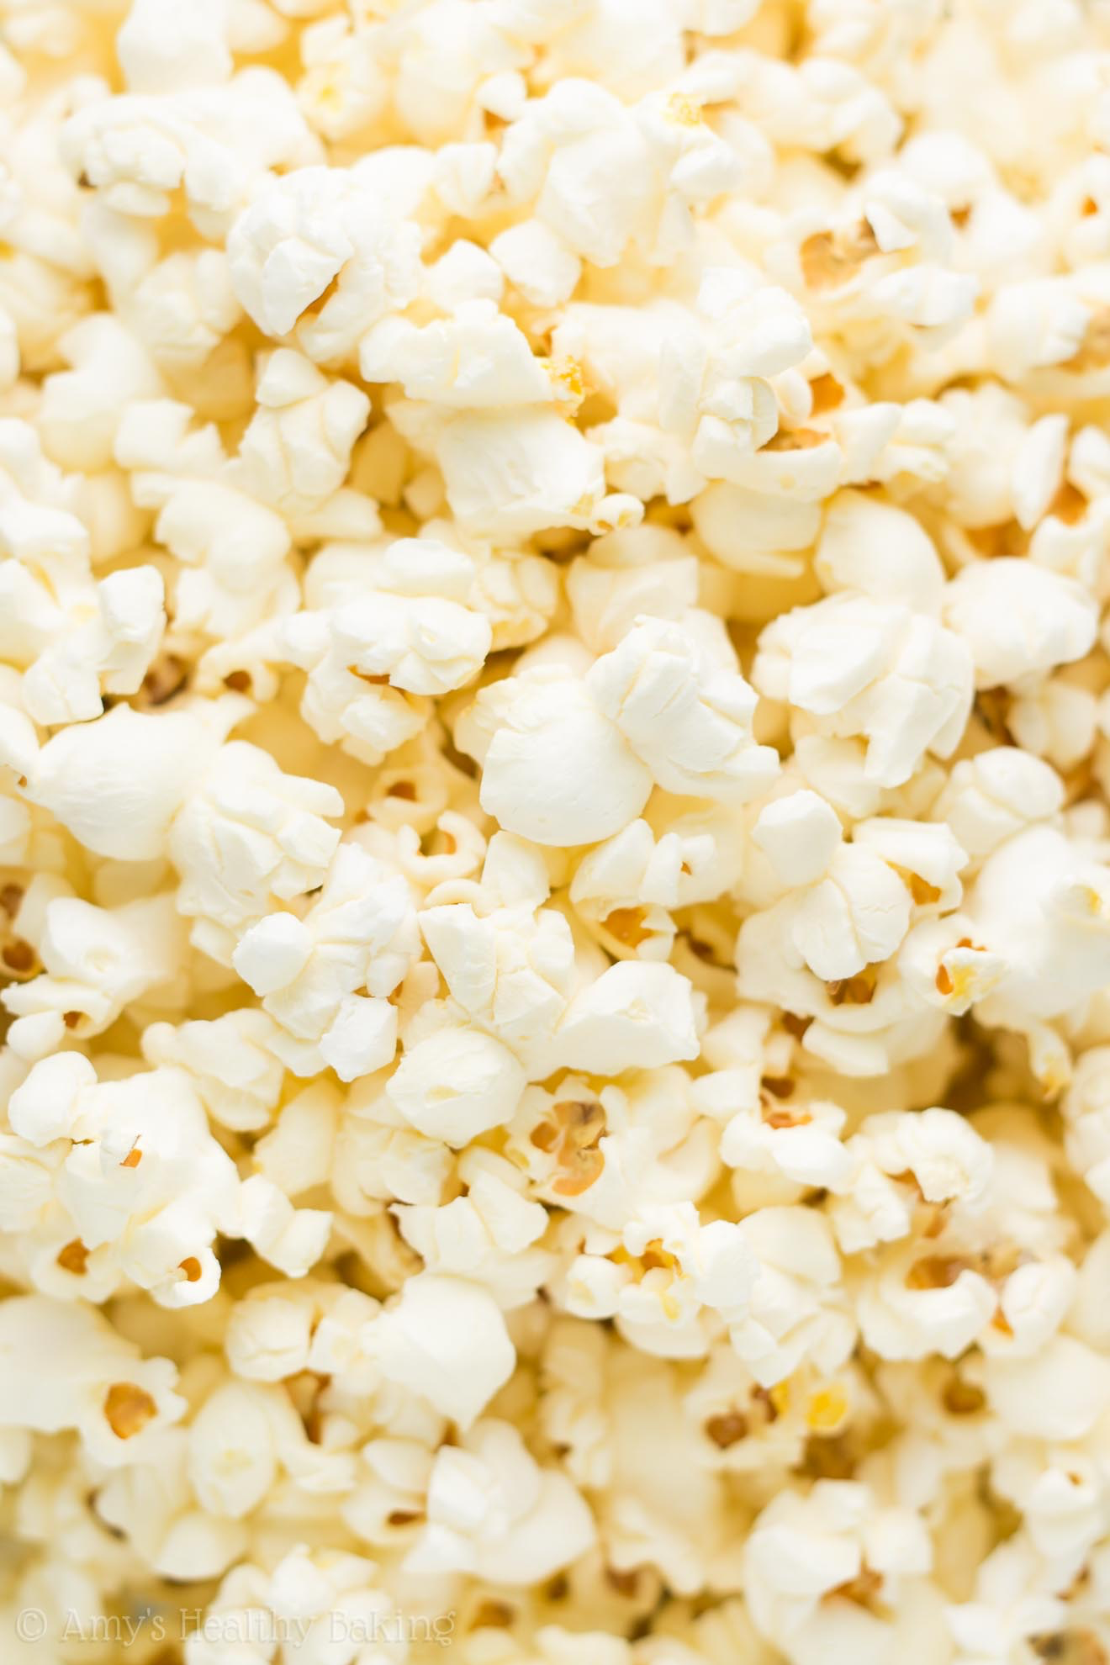
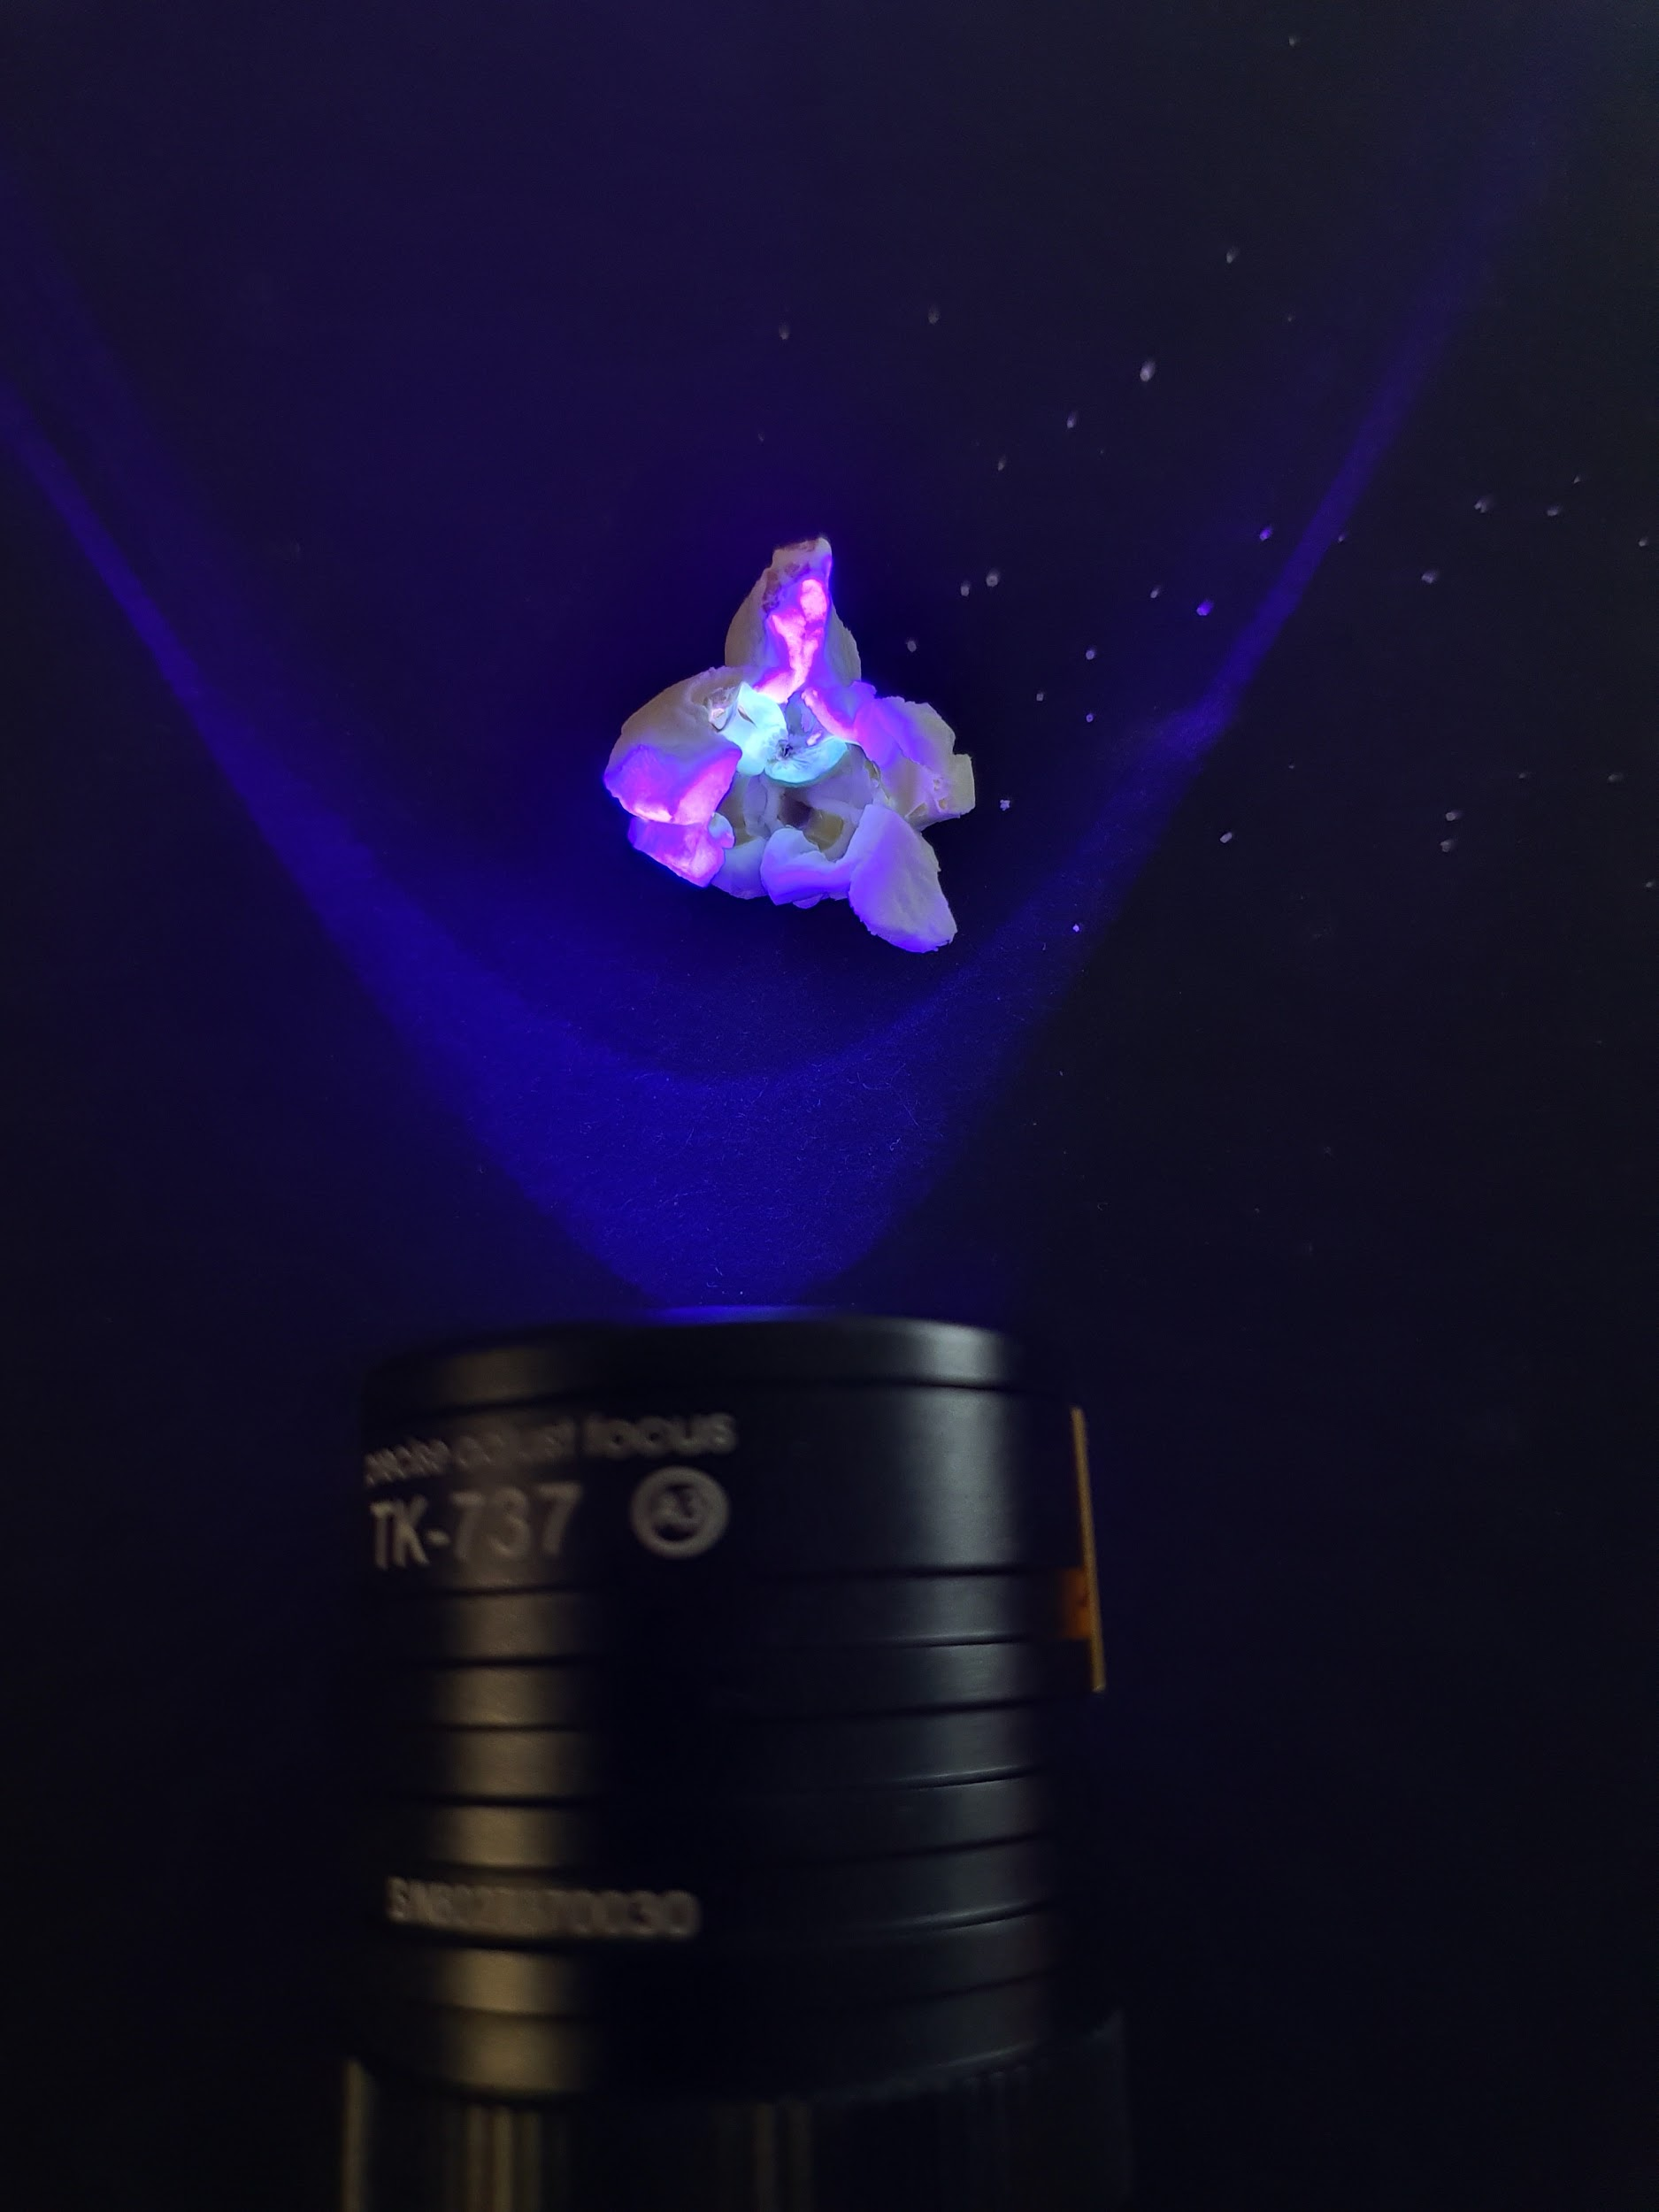

Slide 5
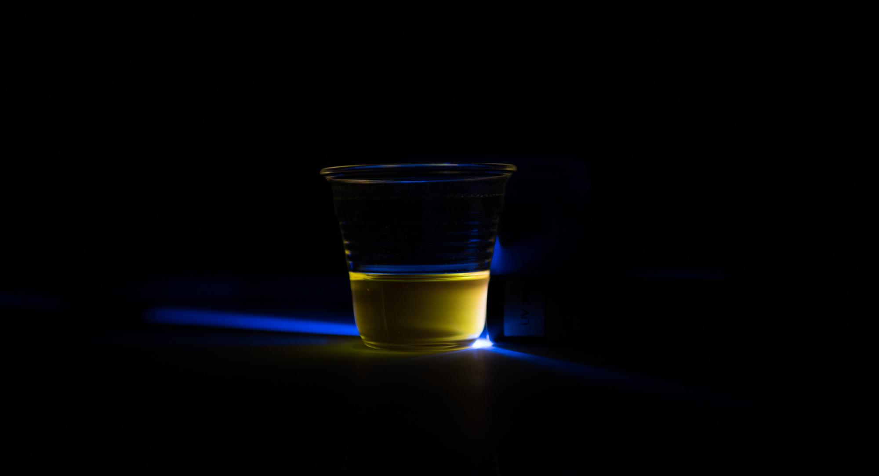
Build a low-cost sensor that can learn to solve multiple tasks on-site without prior-knowledge

Slide 6
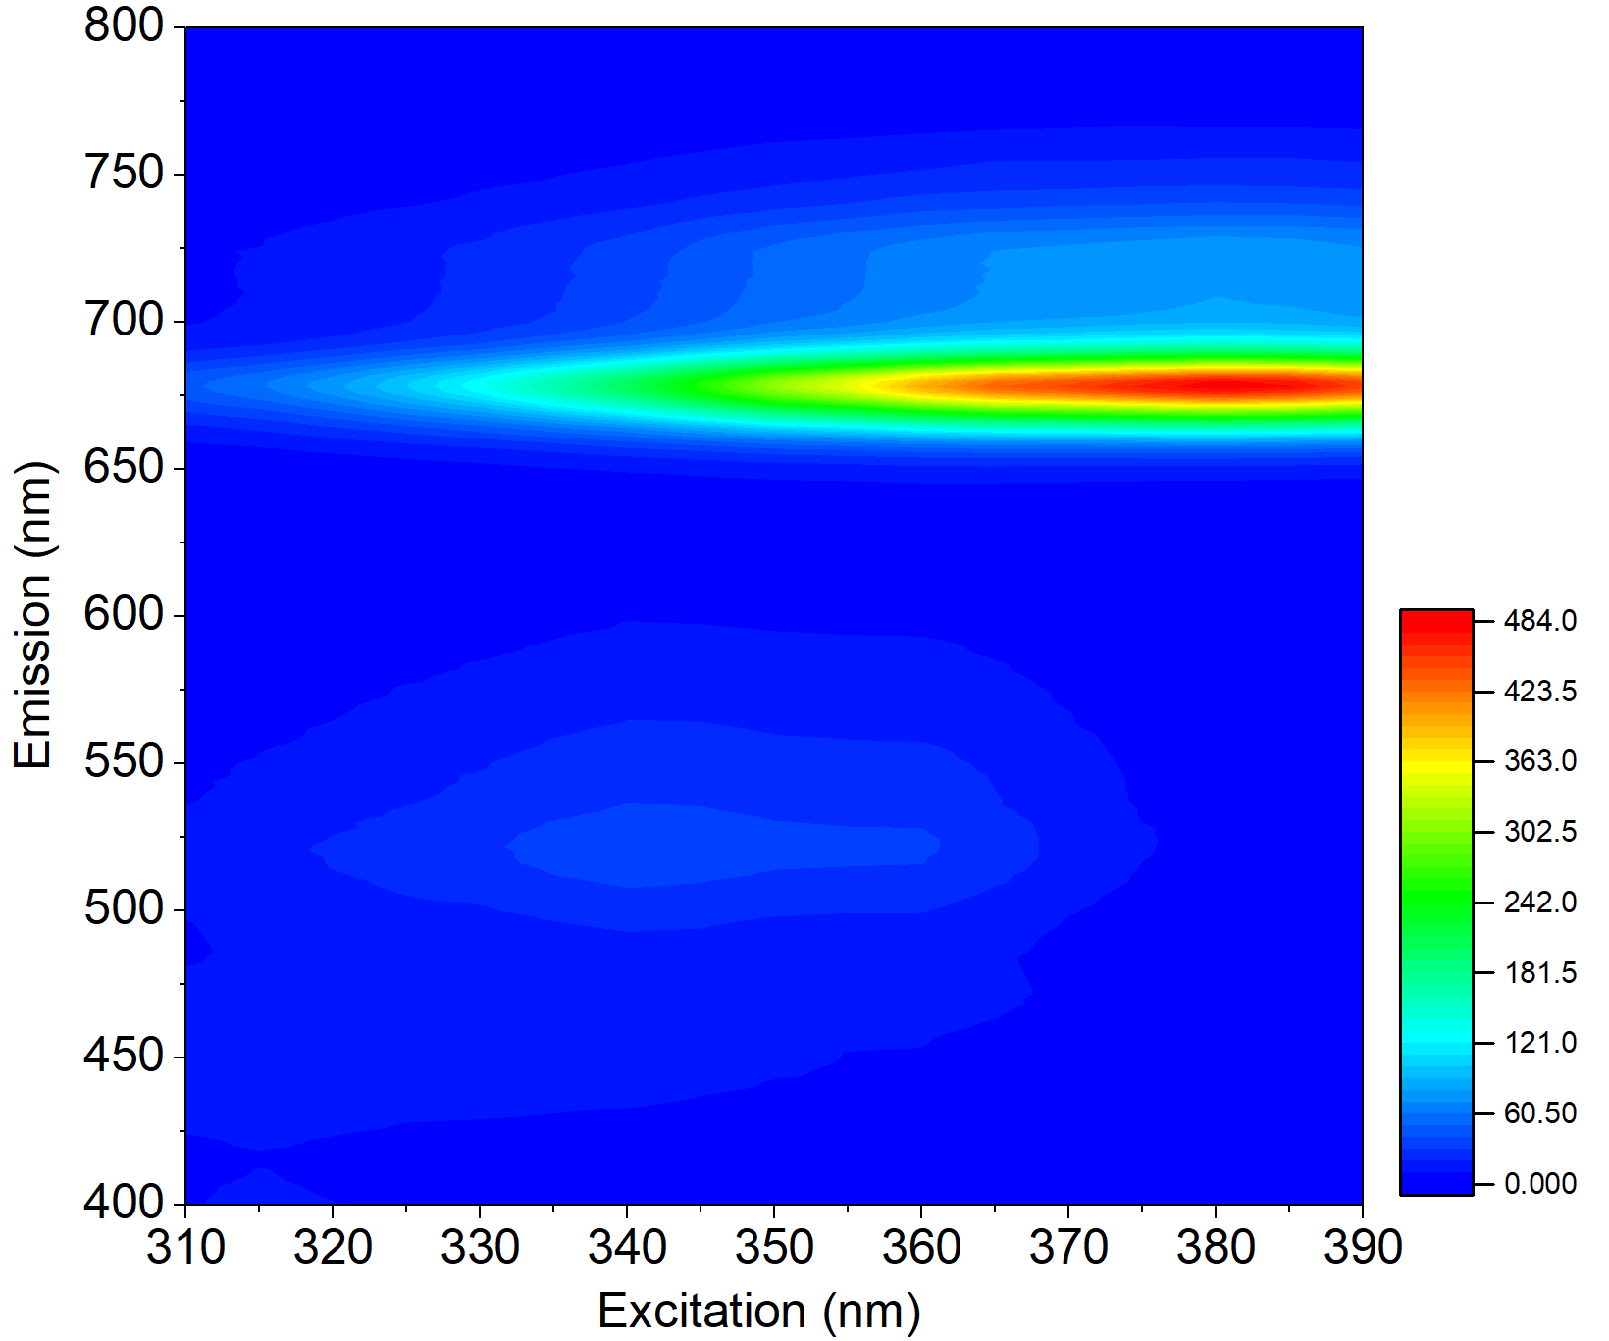
Luminescence enables a unique fingerprint
Fingerprint of olive oil
By changing the wavelength of the excitation and measuring the emission spectrum it is possible to crate a unique fingerprint
Application to food: oil, wine, honey, tea, etc.
Luminescence intensity (a. u.)

Slide 7
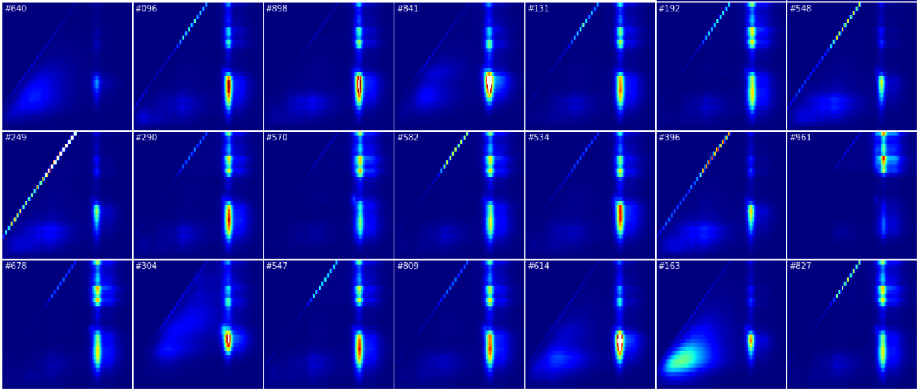
Luminescence enables a unique fingerprint of oil

Slide 8
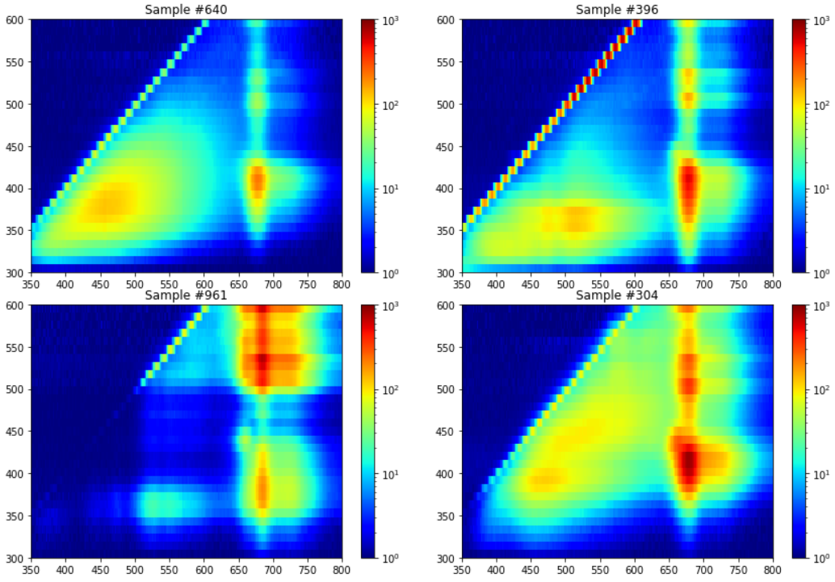
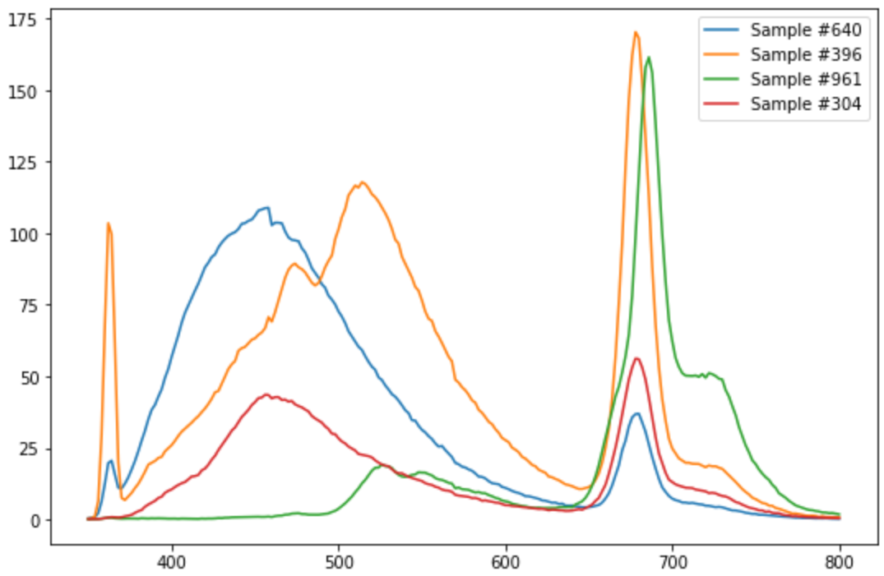
Is fingerprinting possible also with few key excitation wavelengths?
Luminescence intensity (a. u.)
Spectra with excitation at 360 nm
Excitation (nm)
Intensity (a. u.)
Excitationn (nm)
Emission (nm)
Emission (nm)
Emission (nm)

Slide 9
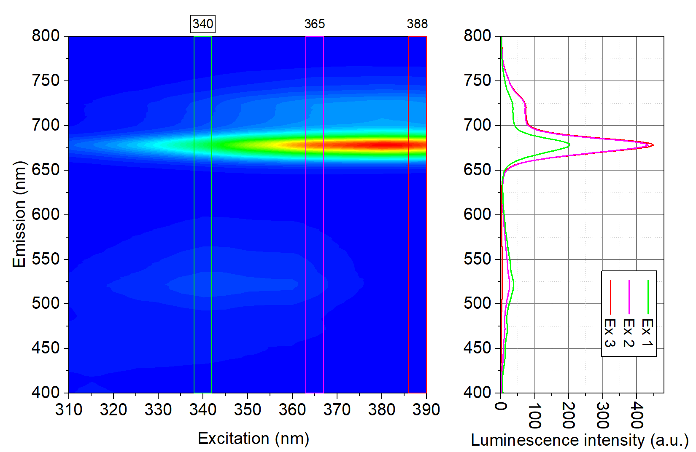
Fingerprinting is possible also with few key excitation wavelengths
Ex 1
Ex 2
Ex 3
Example:
Excitation at 340 nm, 365 nm, 390 nm

Slide 10
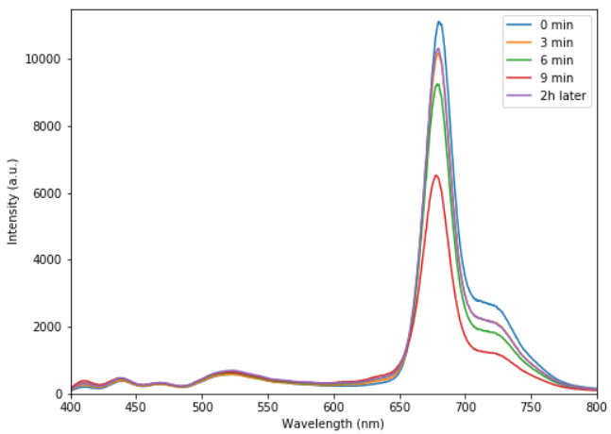
Challanges of luminescence fingerprinting
Temperature quenching
Bleaching
Stability of light source
Expensive instrumentation
…
Spectral changes of EVOO over time with excitation at 365 nm

Slide 11
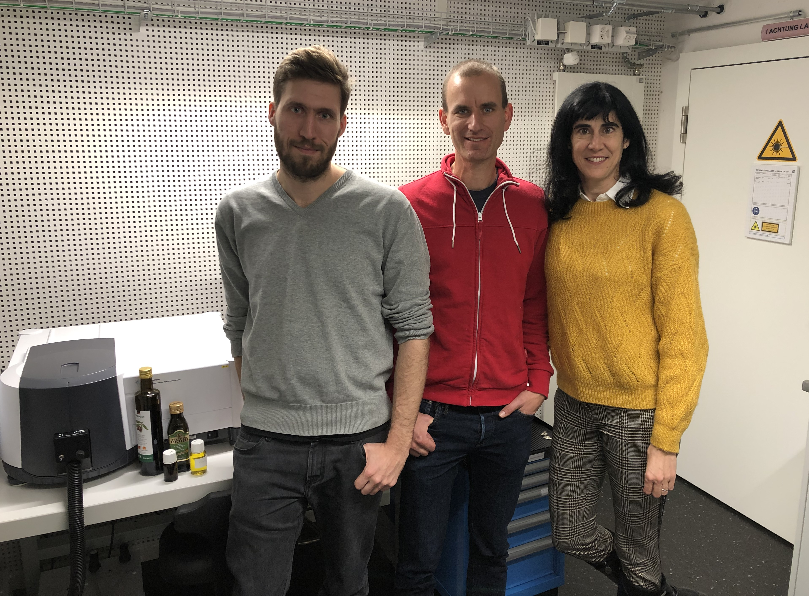
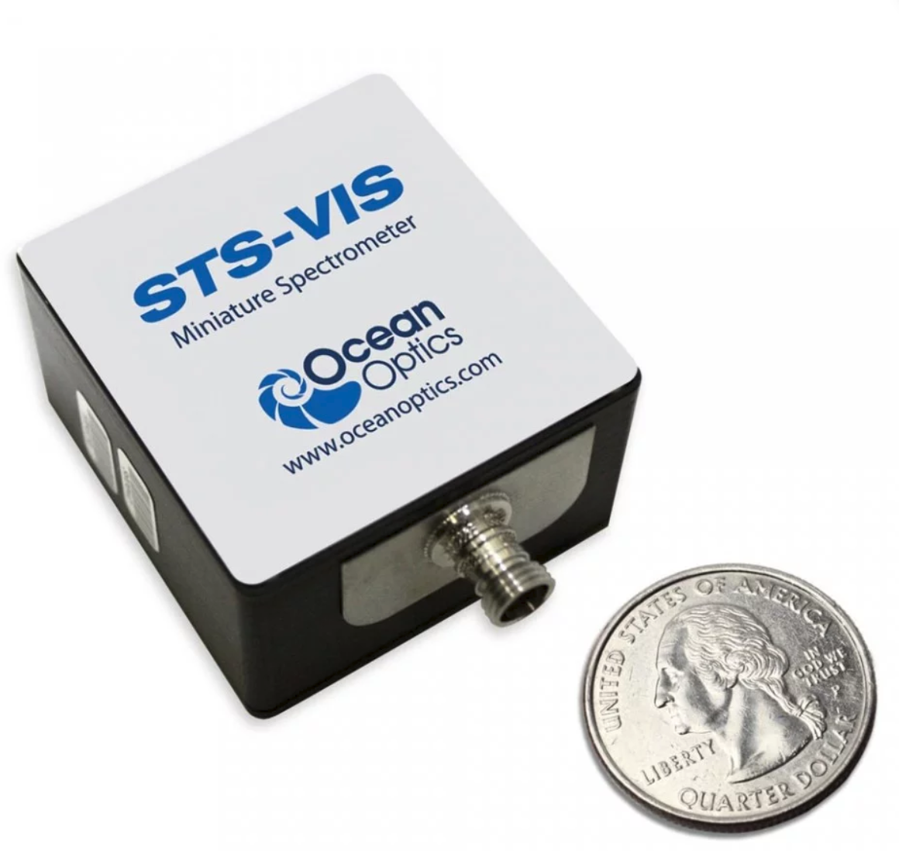

Idea: use AI to overcome challanges
Low-cost system:
UV-Blue LEDs for excitation
miniaturized spectrometer
neural network implemented on R-Pi
AI:
No mathematical model for spectra
The neural network learns from measurements performed with spectrometer to distinguish between the substances
Innosusse Project Nr. 36761.1 INNO-LS

Slide 12
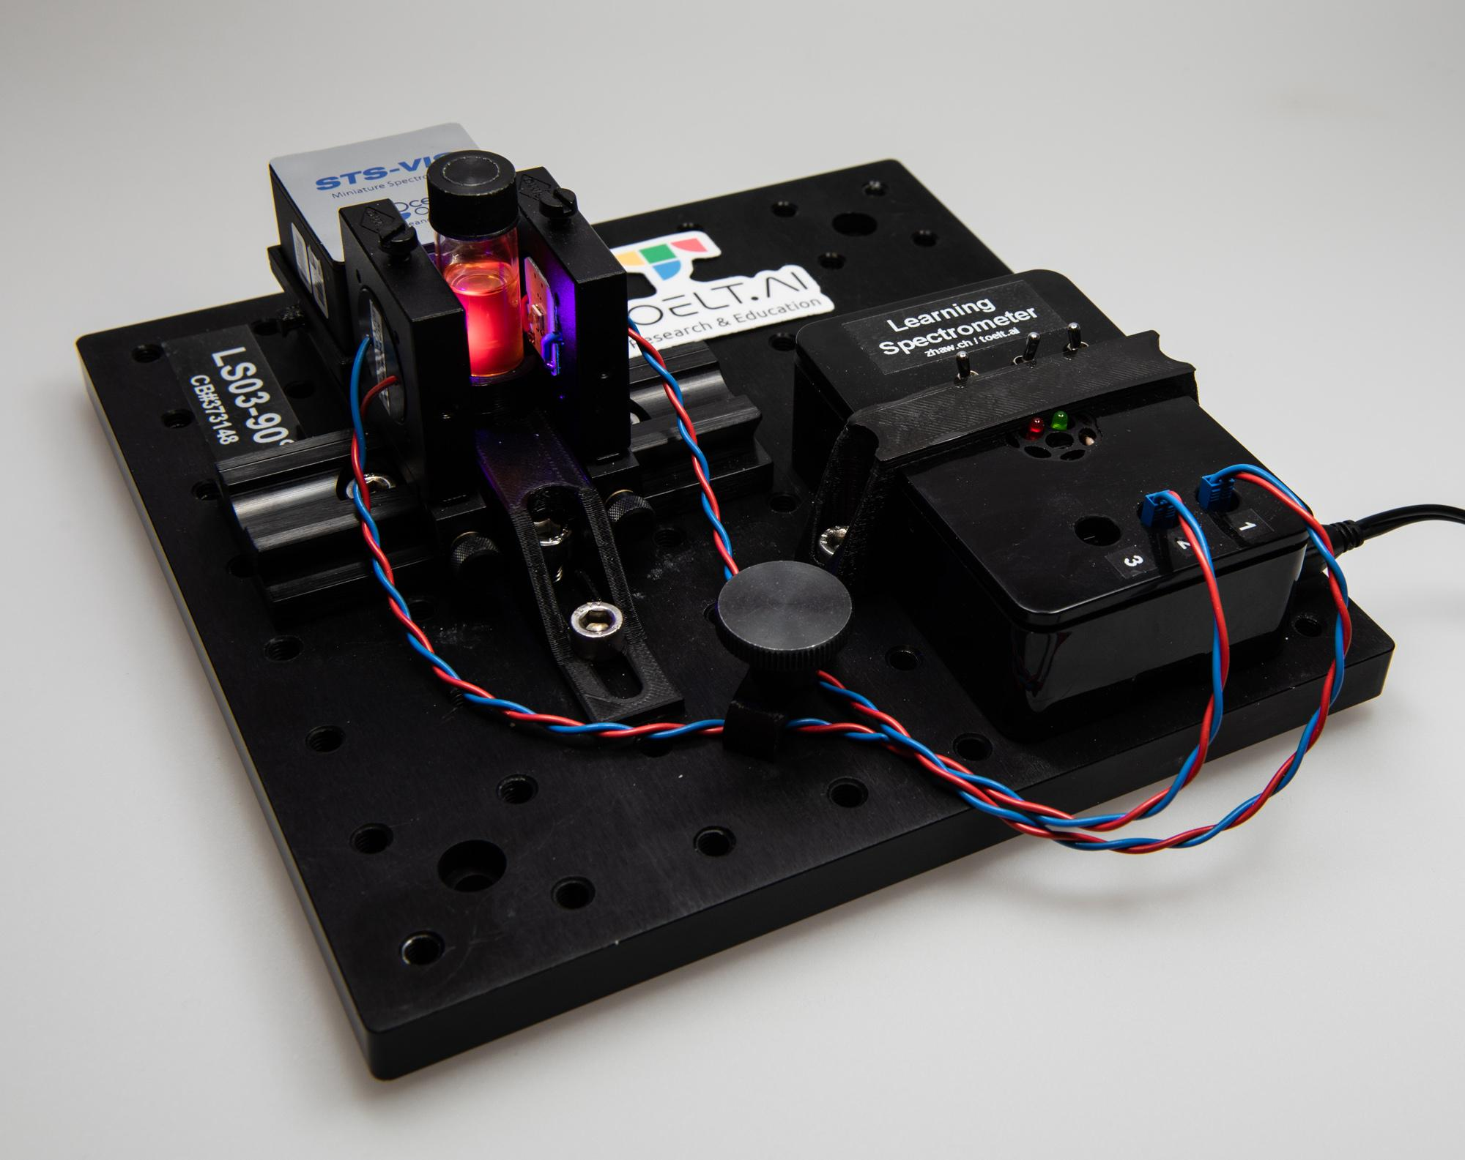
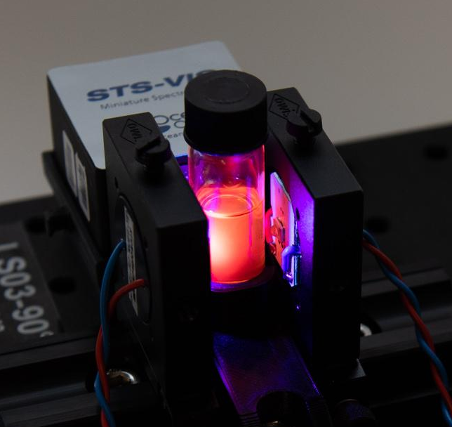

Slide 13
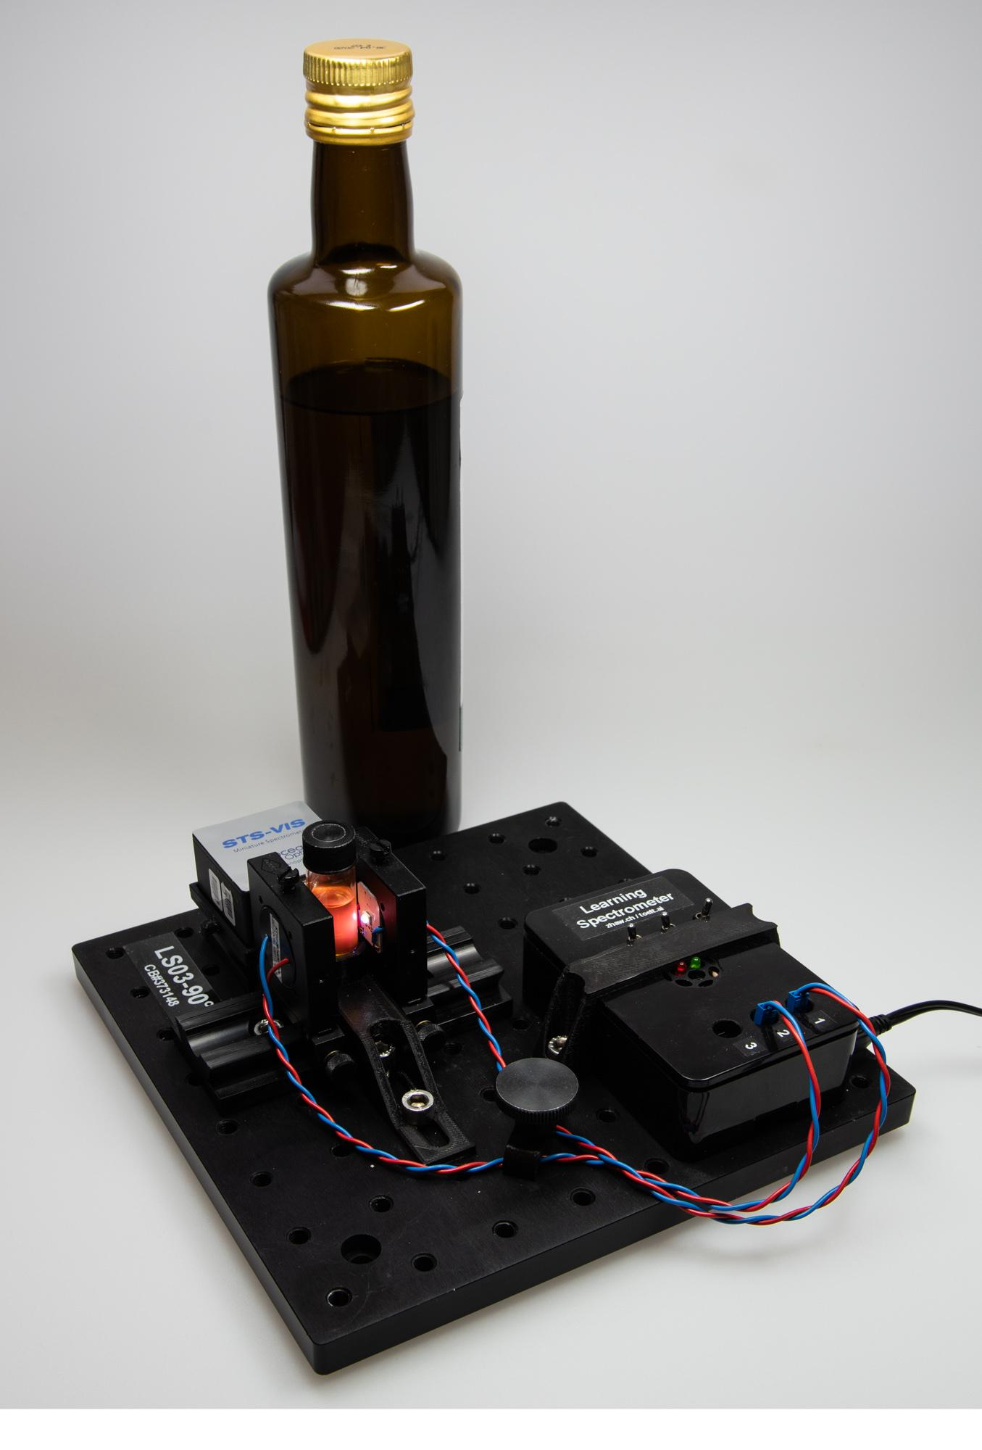

Slide 14
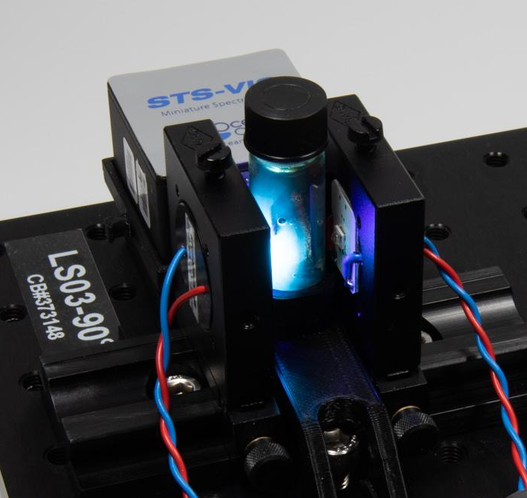
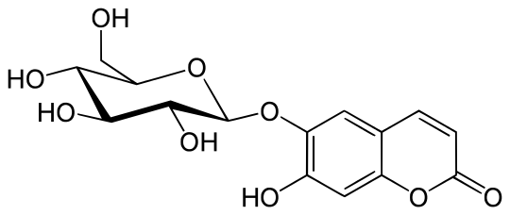
Aesculin
Horsechestnut-tree

Slide 15
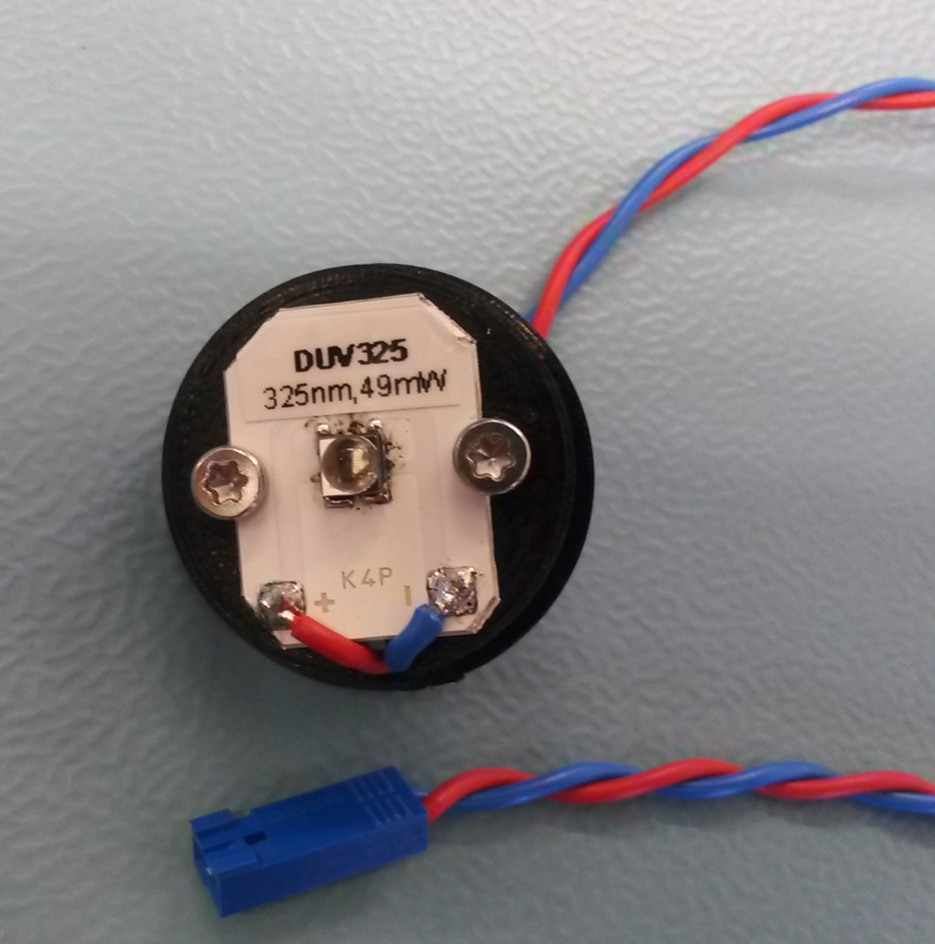
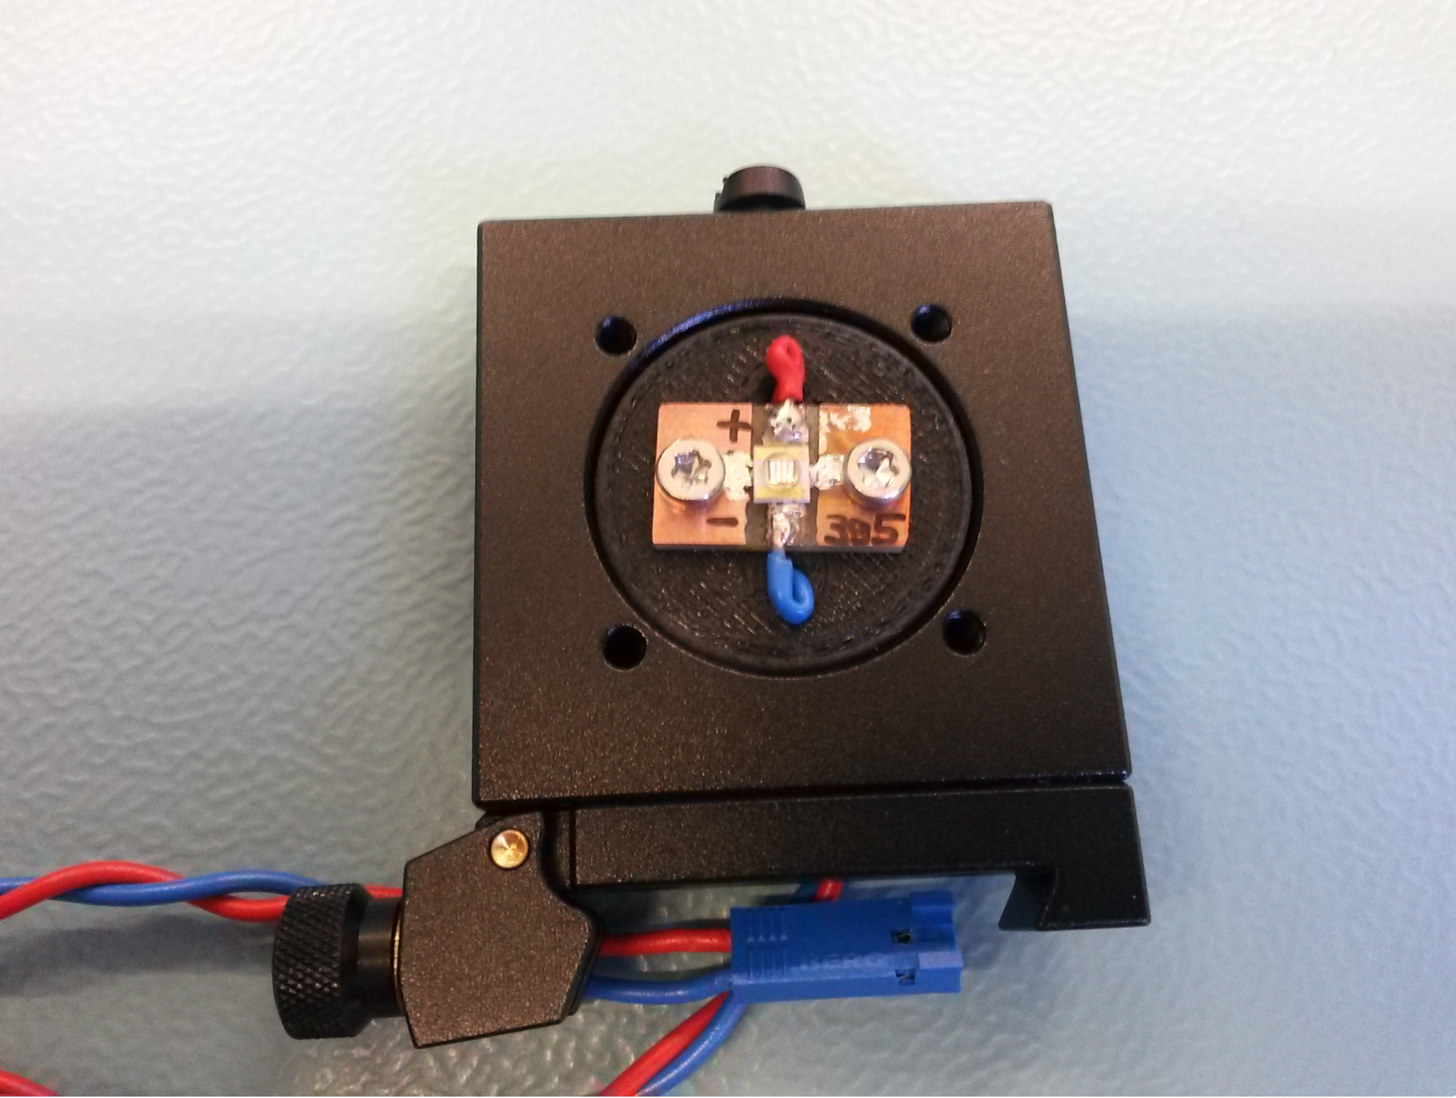
Excitation LEDs

Slide 16
Test: recognise EVOO from OV
A: Extra virgin olive oil 1
E: Olive oil 2
B: Extra virgin olive oil 2

Slide 17
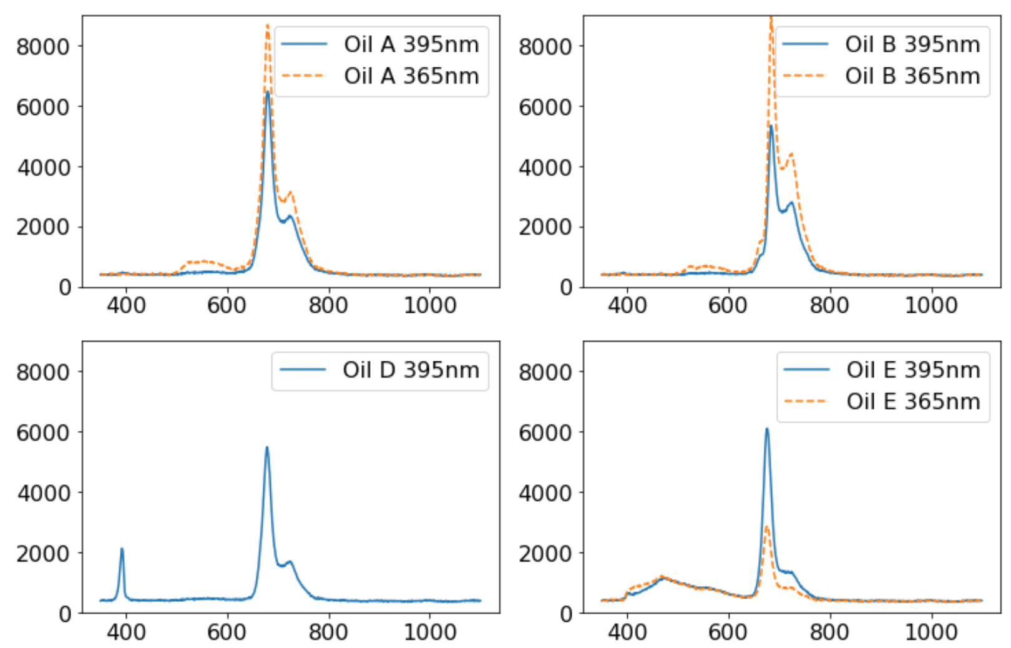
Luminescence spectra are strongly different, even for a single excitation
Intensity (a. u.)
Emission (nm)
Intensity (a. u.)
Intensity (a. u.)
Emission (nm)
Emission (nm)

Slide 18
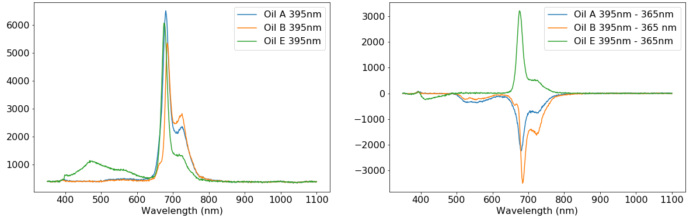
Difference of spectra enhances differences between oils
Luminescence spectrum
Difference of spectra
Intensity (a. u.)

Slide 19
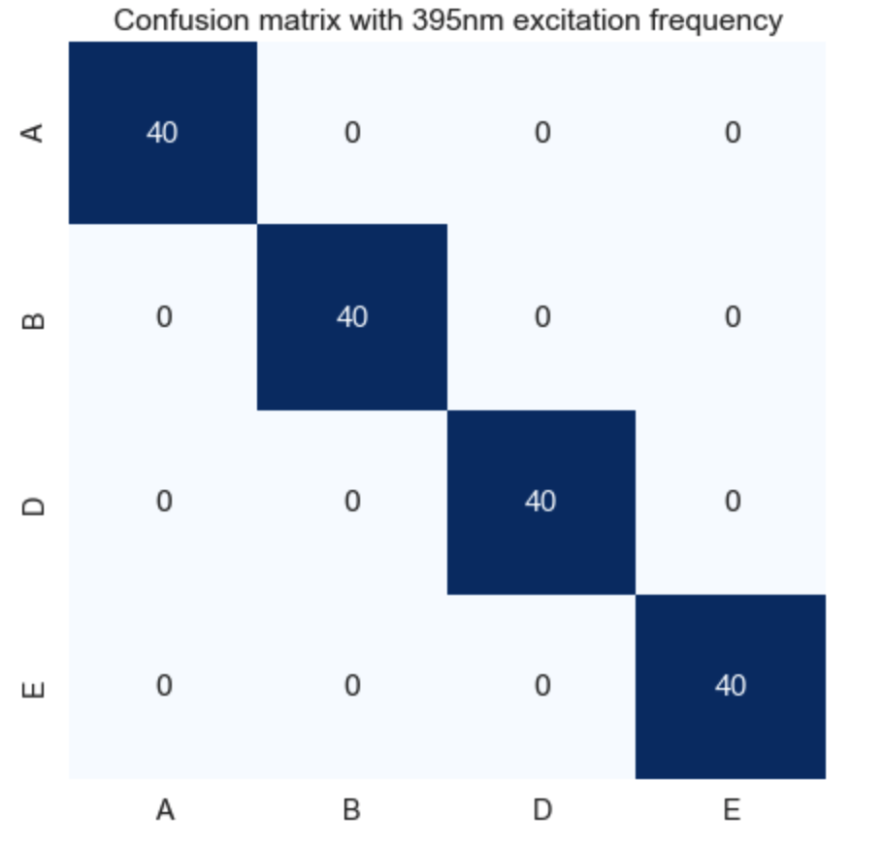
How good can a network be?

Slide 20
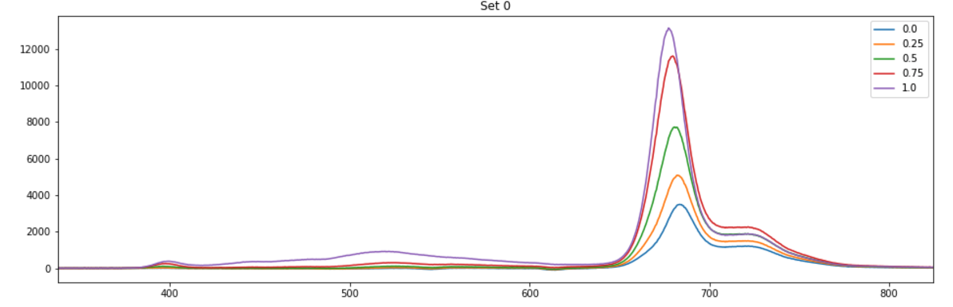
Oil diluition – Preliminary results
Mixtures of two oils: Berio EV and Coop PrixGarantie (mixed refined & vergine oil)
Ratios: 0% 25% 50% 75% 100% of PrixGarantie Oil (100% pure PrixGarantie, 0% pure Berio)

Slide 21
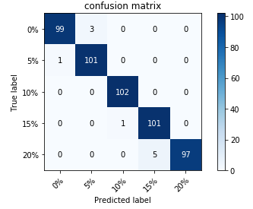
Preliminary results for detection of diluition of EVOO with OO

Slide 22
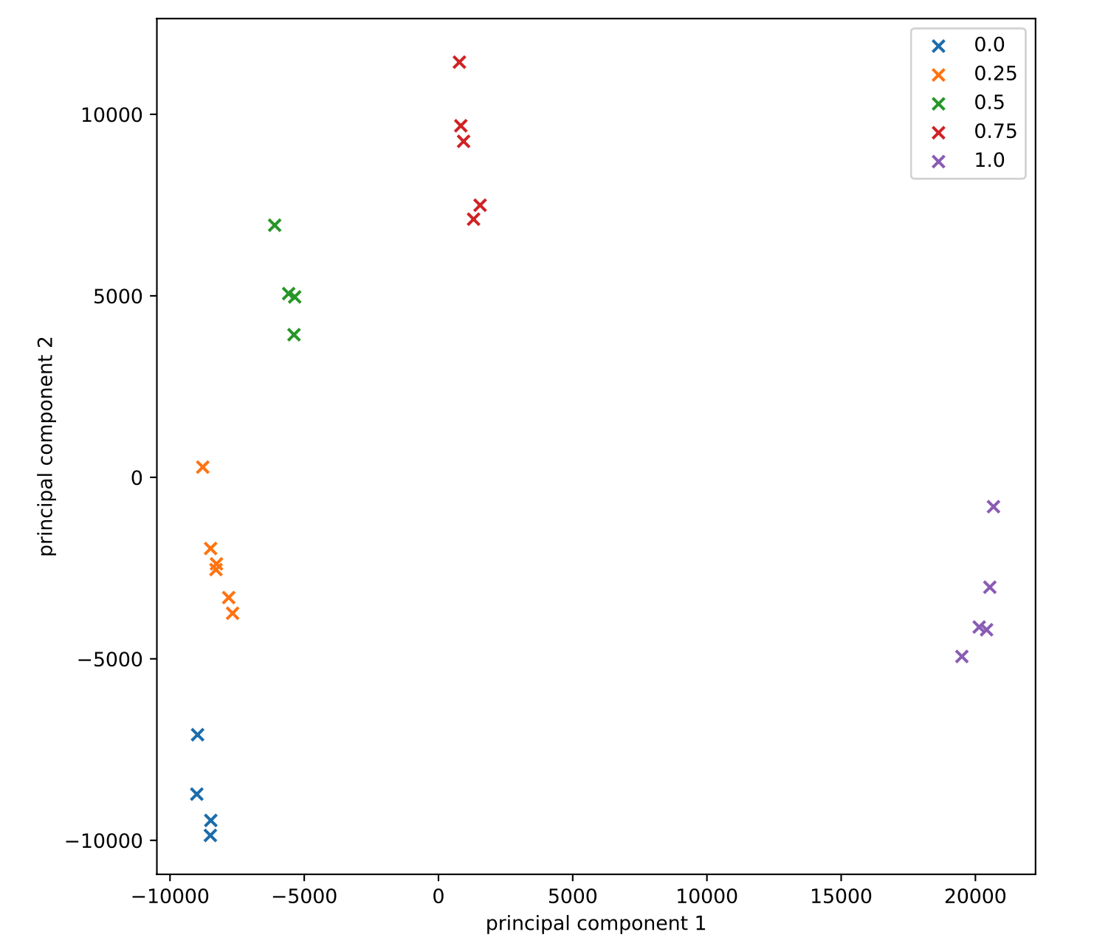
Oil diluition
75 %
Berio Olive Oil diluited with increasing proportions of low quality hazelnut oil
A network can reach 97% of accuracy
50 %
25 %
100 %
0 %

Slide 23
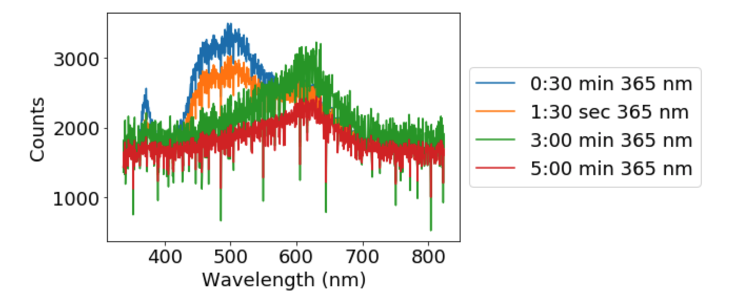
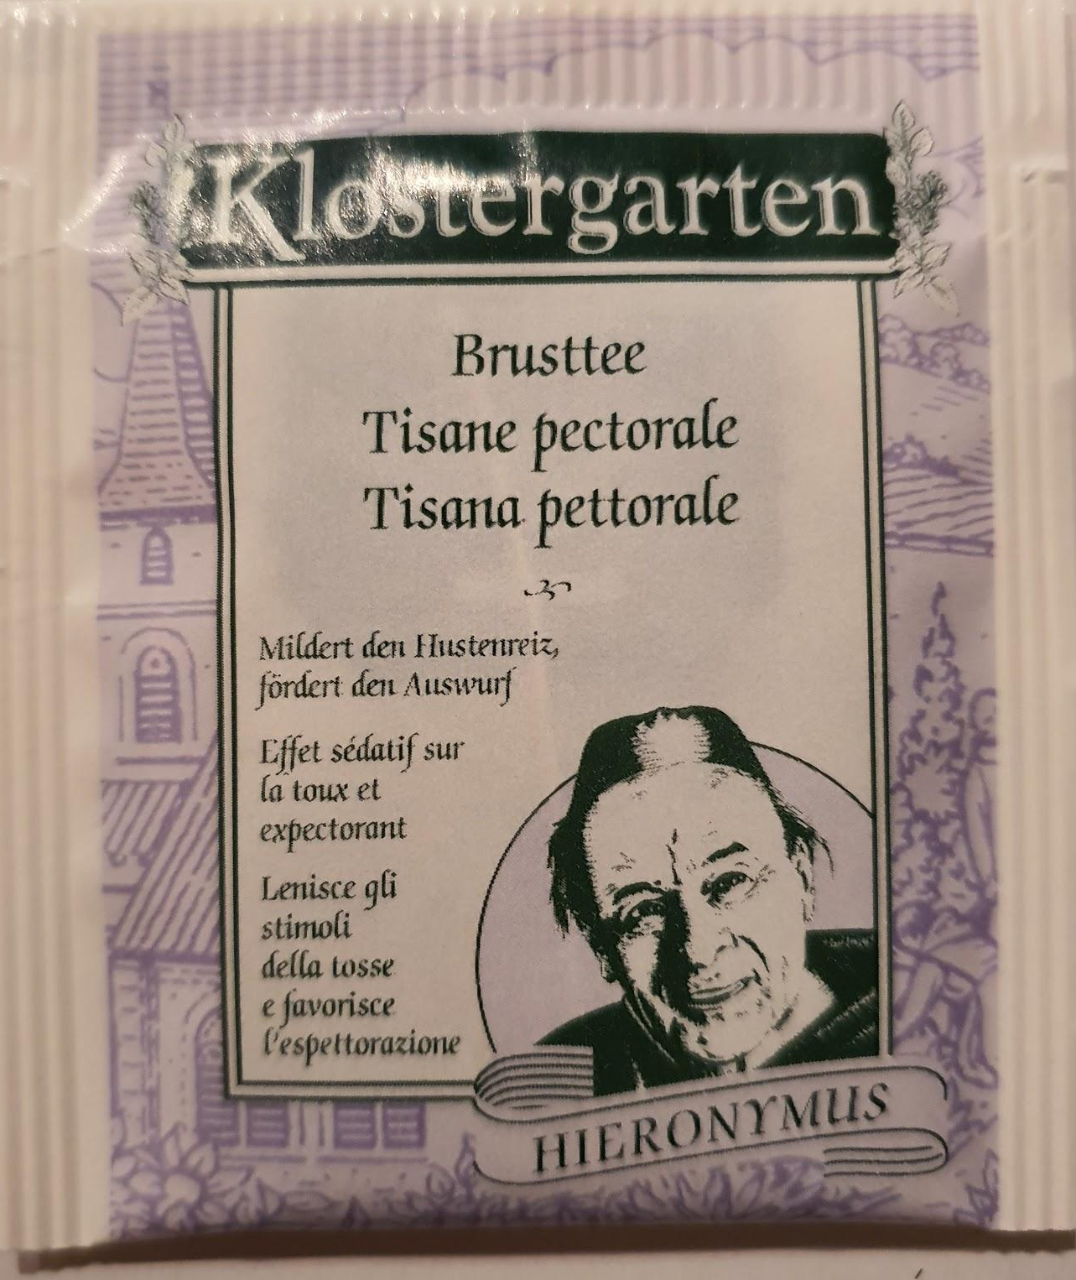
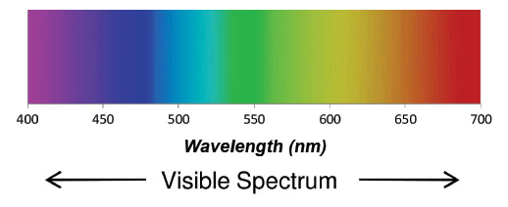
How long should you brew your tea?

Slide 24
Fluorescence gives us a framework for solving a set of tasks with neural networks
Define Task
Prepare Dataset & labels
Purpose / Task / Goal
Fluorescence spectroscopy allows us to frame a huge amount of different problems in the same technical framework (same kind of inputs, same kind of network to be used, same kind of difficulties)
We can search for a solution that works for many tasks at the same time

Slide 25
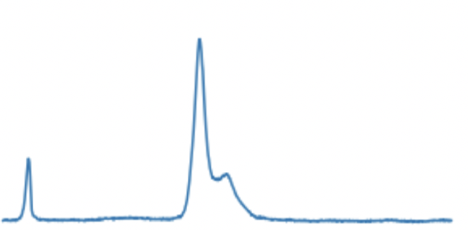
Fluorescence gives us a framework for solving a set of tasks with neural networks
We can frame almost all problems as classification problems
Variability of input observations
Input format
Sample measurements are extremely reproducible
Example: oil diluition estimation as a classification problem
Class 1 → 10%,
Class 2 → 20%,
etc.

Slide 26
There are two reasons why a solution can be general
Overfitting presents itself in a completely different form (aka is not relevant)
Each task, when taken by itself, is relatively easy to solve so a network does not require much fine tuning (hyper parameter tuning)

Slide 27
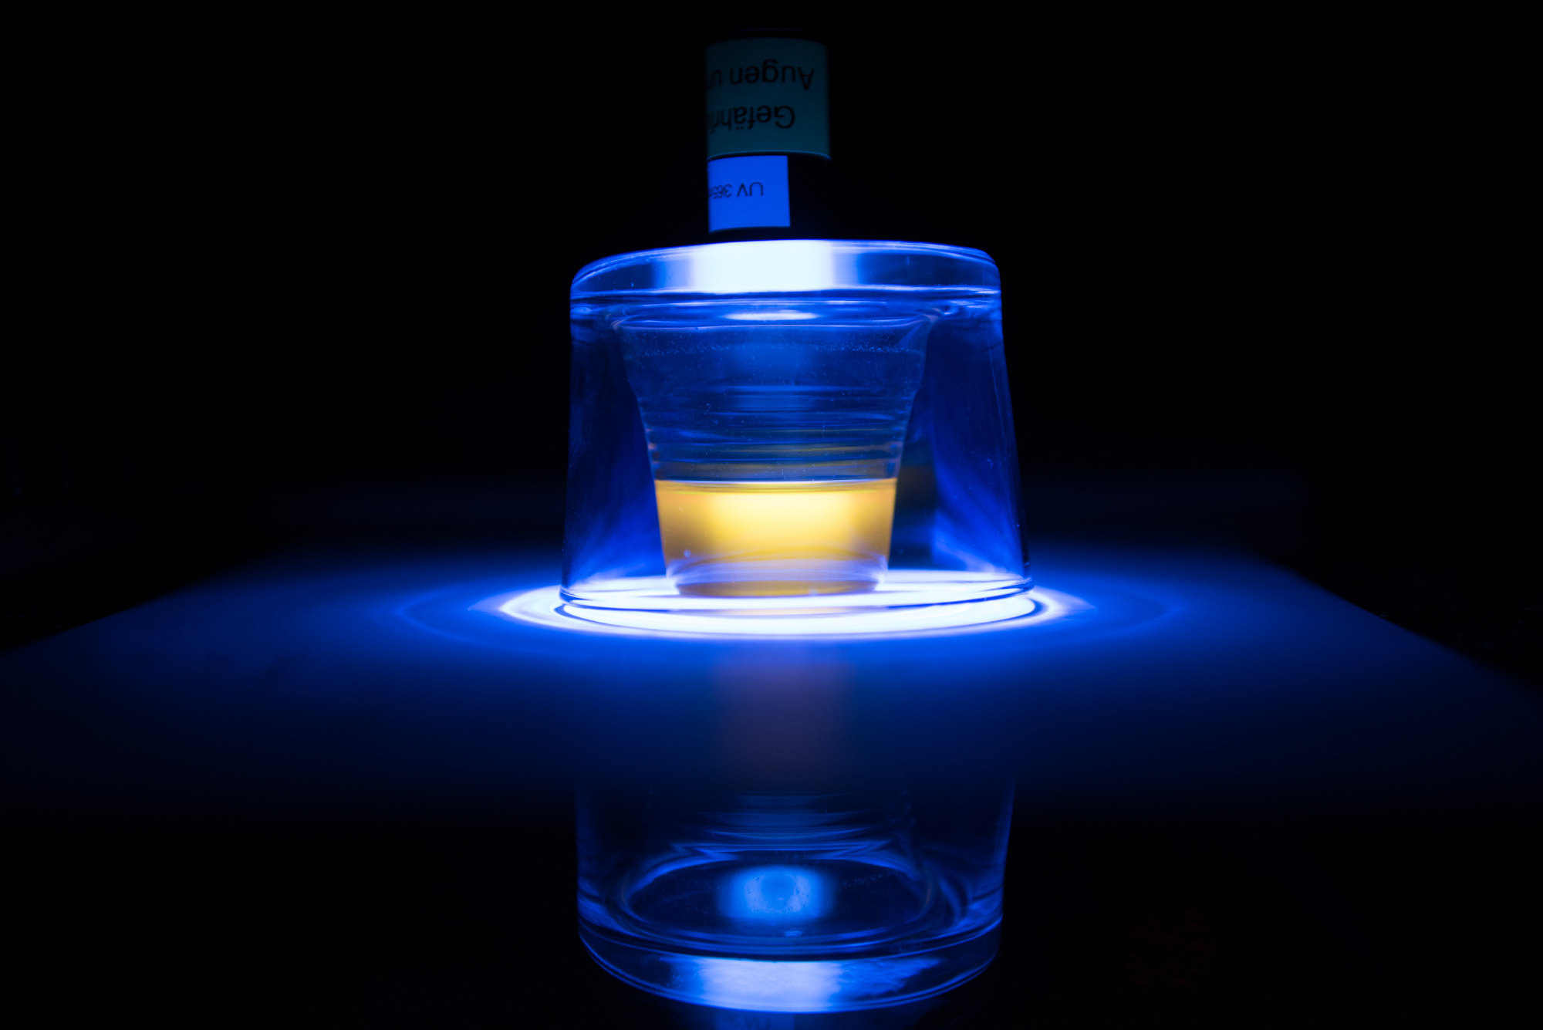
Beyond taste…

Slide 28
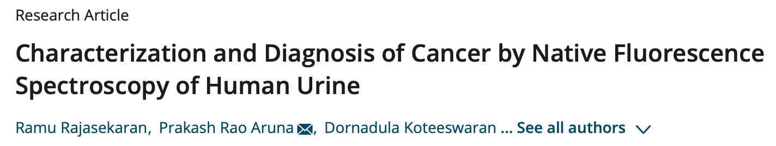
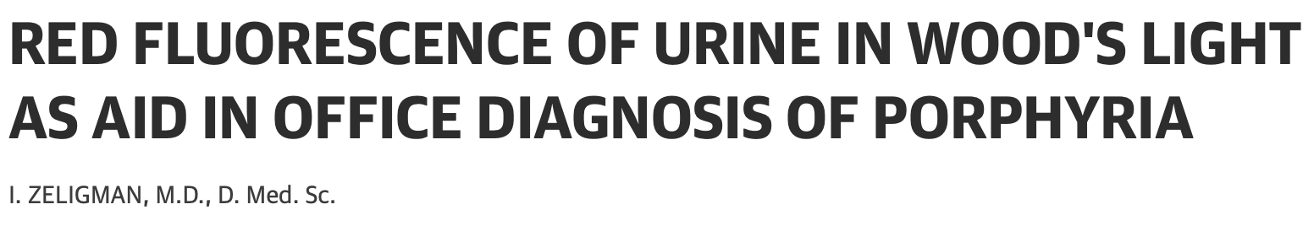


Slide 29
